Slide 1

Group D AIR TICKET BOOKING SYSTEM

Slide 2
Summary
Executive Summary
Our Understanding and Approach
Scope of Work
Out of Scope
Technology Landscape
Proposed Architecture
DevOps/MLOps
Proposed Team – Short Term
Project Phases & Timelines
Dependencies & Assumptions
EDA

Slide 3
Executive Summary
The Air Ticket Booking System is a web application for purchasing airline tickets online.
This system enables tracking the flight delay before the arrival and departure if any.
Our objective is to allow customers to search for flights, view available flights, and purchase tickets with ease.
Our key features include delay predictions of the flight beforehand so that the customer can book the flight tickets accordingly.
A machine learning model is built to predict flight delays to be represented in the air ticketing system.

Slide 4
Our Understanding and Approach
Our Understanding
We need to develop an online web application for purchasing airline tickets that allows consumers to choose their destination, point of origin, and departure date. All flights that are now available should be shown in the system with an average delay prediction based on the parameters.
Features:
We need to create a web app where users can search the Flight based on origin and destination .
The Admin has a provision to update the Flight details in the system.
The System should show the Expected delay based on historical data.
Our Approach
Backend: Python with Flask framework for building the API and handling database connections
Frontend: HTML, CSS, and JavaScript for building the user interface
Database: MySQL for storing flight data and user information
Machine Learning: Use historical flight data to predict expected delays for each flight
Deployment: Docker containers for packaging and deploying the application

Slide 5
Scope of Work -Frontend
The scope of work for the online airline ticket purchasing system includes the following:
Design and development of a web application that allows users to search for flights based on their origin and destination, and book tickets online.
Designing and implementing the UI of the web application, which includes the layout, color schemes, typography, and graphics.
Developing responsive web design that will enable the application to function seamlessly on different devices and screen sizes.
Testing the application's UI and UX to ensure that it is intuitive and easy to use.
Provision for the admin to update the flight details in the system.

Slide 6
Scope of Work-AI/ML
The model will predict the arrival delay based on users' choice of flight.
The model to be built is a supervised regression model, which provides total delay caused during a journey.
By performing exploratory data analysis on the dataset, the identified features for building the machine learning model are : ARR_TIME, ORIGIN, DEST and WHEELS_ON.
The target variable for the prediction will be: ARR_DELAY.

Slide 7
Scope of Work-Backend
Developing the webpage authentication and authorization system to manage user access, roles, and permissions.
Creating and maintaining the database that stores data such as passenger details, travelling date ,class, number of persons ,seat booked.
We will implement various security measures such as SSL encryption, two-factor authentication(optional).
To Provide ongoing maintenance and support for the back-end of the web application, including bug fixes, system upgrades, and performance optimization.

Slide 8
Scope of Work
The scope of work for this system includes:
User
Login Page
User authentication and authorization
Sign Up Page
User sign up for creating new account.
Home Page / Dashboard
Basic information such as Flight Searching, Departure Date , Class, Return Date, Traveler count.
Search Results
Basic information such as (Flight Details, Time of the flight, Date of the flight, Expected delay)about the Flight requested by the user.

Slide 9
Scope of Work
Passenger Details
Information about the passenger details who are traveling in the flight.
Select Seats
To select the seats as required by the user
Boarding Pass
Information about the complete details of the flight and the journey as well as the passengers details

Slide 10
Out of Scope
The following tasks are out of scope for the project:
Integration with other travel services such as hotels, rental cars, etc
Payment gateway Implementation.
Mobile application development.
Integration with social media platforms.

Slide 11














Technology Landscape
Front End
Back End
Other
AI/ML

Slide 12
DevOps/MLOps
Version Control:
GitHub Flow version control system is to be used to manage the code throughout the project.
This makes it easier to manage changes to the code, and ensures that the code can be rolled back if needed.
DevOps Platform:
GitLab will also serve as the DevOps platform to automate the software delivery process. It will be used to automate builds, testing, and deployment of the application.
Containerization:
Docker is used as the containerization tool to package the code into containers.
It can help to deploy and manage the application, and ensures that it can be deployed consistently across different environments.
Model Management :
Model management will be deployed in both Jupyter Notebook and Google Colab so as to benefit from the individual platform’s advantage over the other.

Slide 13
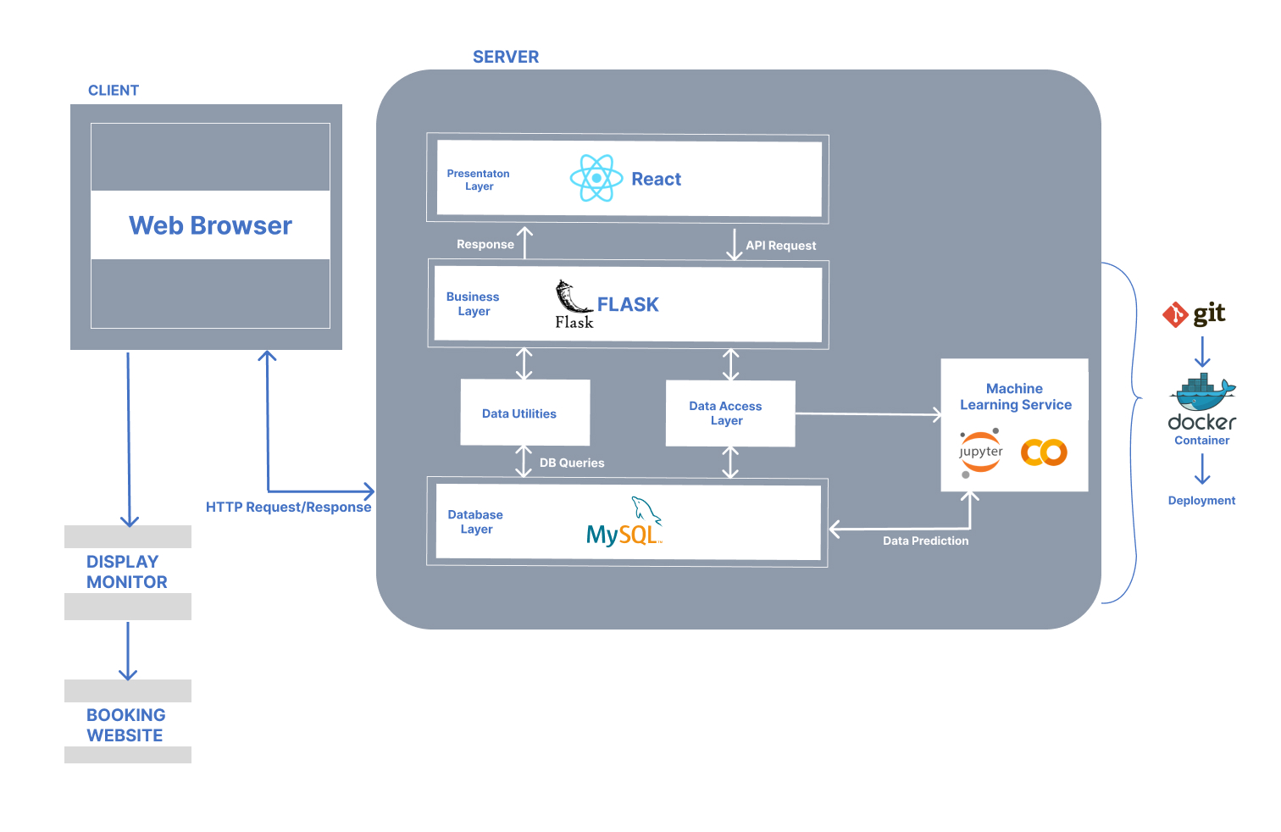
Proposed Architecture

Slide 14
Proposed Team – Short Term
NAME | BRANCH | AREA
SREERAM K R | ECE | Backend
U HARI KRISHNAN | CSE | Frontend
HARITHA KJ | EEE | AI/ML
ASHIK KJ | AI | AI/ML

Slide 15
Project Phases & Timelines
March
April
May
June
July
Requirements
Demo 1
Demo 2
Demo 3
Final Demo
Project Phases:
End of April - Discovery Phase
Deliverable 1: Project Pitch
Deliverable 2: UI Prototype
Deliverable 3: User story
End of May – Initial working demo
Website with basic functionality
Finalization of ML Model
End of June:
Fully Functional Website with integrated frontend, backend and AI/ML Model.
End of July:
Final Demo and Deployment of proposed website

Slide 16
Dependencies & Assumptions
There are several dependencies and assumptions that need to be considered for the successful completion of the project.
Dependencies:
Availability of relevant historical data for the ML model training
Availability of necessary APIs for accessing the airline data and integrating it into the system
Availability of relevant development tools and software packages
Availability of cloud infrastructure for hosting the application and the ML model
Assumptions:
The historical data is accurate and reliable
The APIs will be available and stable throughout the project timeline
The development tools and software packages will be compatible and readily available
The cloud infrastructure will be secure and scalable to meet the system requirements

Slide 17
Exploratory data analysis
Problem Statement & Need of solving
Air delay is a common problem in the aviation industry that causes inconvenience to passengers and airlines. It refers to the situation when a flight is delayed due to various reasons such as weather conditions, technical issues, or other unforeseen circumstances.
Air delay can cause inconvenience and frustration to passengers who may miss their connecting flights or important appointments. It can also lead to decreased customer satisfaction and loyalty towards airlines, resulting in a negative impact on the airline's reputation.
By developing a machine learning project to predict air delays accurately, airlines can take proactive measures to mitigate the impact of delay. This would result in improved customer satisfaction, reduced costs, and a more efficient and environmentally friendly aviation industry

Slide 18
Understanding the dataset
We have taken the dataset '2020.csv' from all the datasets provided because it is the latest dataset among the others and it also has all the features to fulfill the requirements of building the ml model.
Descriptive Analysis
The dataset consists of 27 features, among which:
4 features are object data type, which has to be converted into a numerical value.
1 feature is an integer data type
Rest 22 features are having float data type
The dataset consists of a total of 2547574 entries.

Slide 19
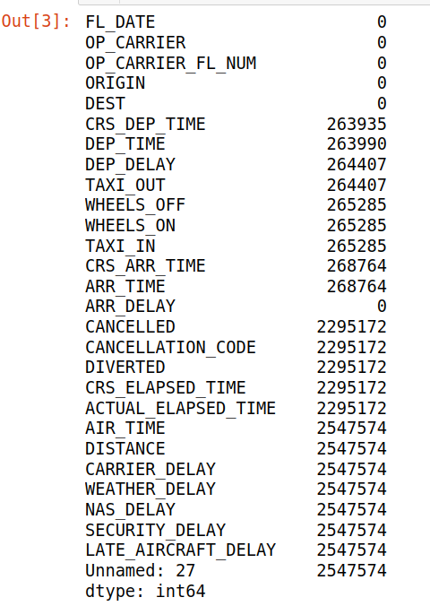
Descriptive Analysis
There are no duplicate values.
22 features are having null values ranging from 2.6 lakhs to 2.7 lakhs each.

Slide 20
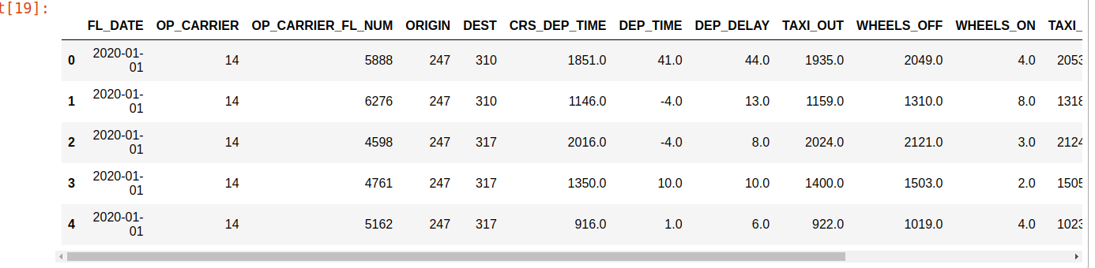
Data Cleaning & Pre-Processing - After cleaning

Slide 21
Diagnostic Analysis
Our main objective is to build a model which can predict arrival delay, as it summarizes all the major delays together.
Thus we have selected certain features for training the model by finding the correlation using a heatmap:
ARR_TIME - Arrival time of the flight
ORIGIN - origin of the flight
DEST - Destination of the flight
WHEELS_ON - actual time the aircraft's wheels touched the ground at the destination airport
The Target features selected are:
ARR_DELAY - Arrival delay of the flight

Slide 22
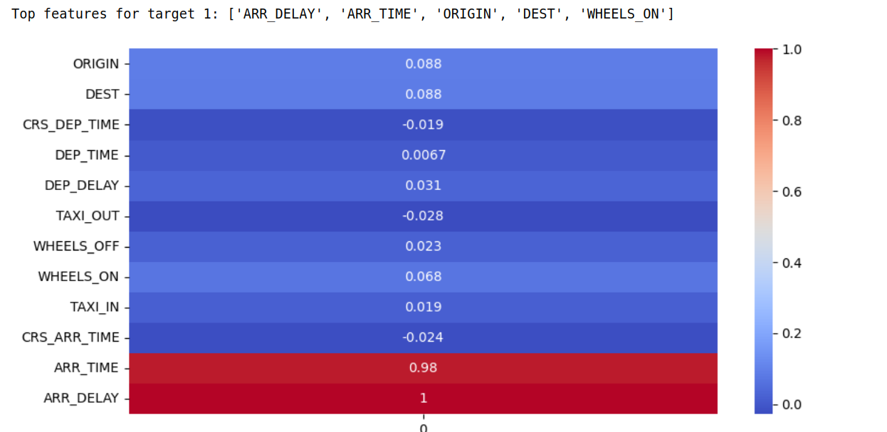
Diagnostic Analysis - HeatMap

Slide 23
Predictive Analysis
From the data we have summarized from the descriptive and diagnostic analyses we can use the following algorithms to make logical predictions of the outcomes of events.
Supervised regression models:
Linear Regression
Gradient Boosting Regression
Decision Trees Regression
Random Forest Regression
Ridge Regression

Slide 24
Predictive Analysis
Performance Metrics:
Mean Squared Error (MSE)
Root Mean Squared Error (RMSE)
Mean Absolute Error (MAE)
R-squared (R2)

Slide 25
Predictive Analysis
The Airlines present in our dataset are:
Windward Islands Airways(WIN), American Eagle Airlines(MQ), Frontier airlines (F9), Express jet airline(EV), Hawaiian Airlines (HA), SkyWest Airlines(OO), United airlines(UA), Envoy Air(MQ), Spirit Airlines(NK), American Airlines(AA), Delta Airlines (DL), Alaska Airlines(AS), Endeavor Air(9E), PSA Airlines(OH), JetBlue Airways(B6), Mesa Airlines(YV)
A few of the Destinations present in our dataset are:
Ontario, San Francisco, San Jose, Sacramento, ORF, Maryland, Orlando, Chicago, West Palm Beach, Atlanta city, Downtown Baltimore, Ronkonkoma NY, Hollywood Way, Portland, Dallas, Denver, Las Vegas, Oakland, San Diego, Atlanta, Philadelphia, St. Louis , Sacramento, Phoenix , Cicero Ave etc.

Slide 26
THANK YOU

